Slide 1

Section B Chat Analysis

Slide 2
Names and numbers have been changed to protect the guilty

Slide 3
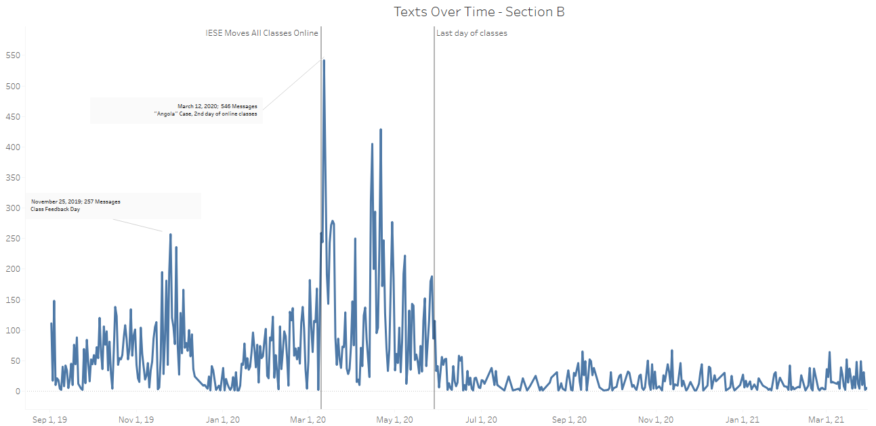
Texts over time

Slide 4
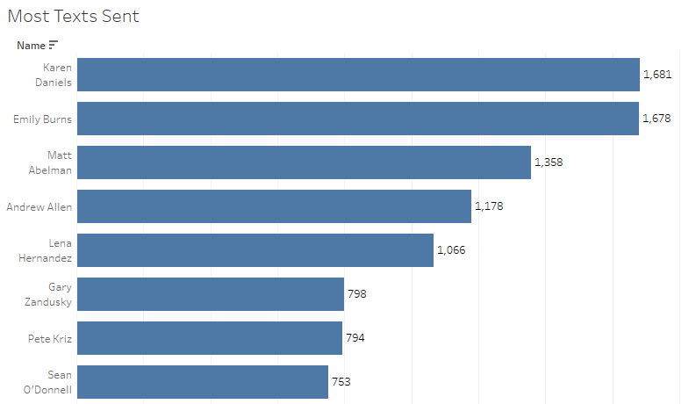
Most texts sent

Slide 5
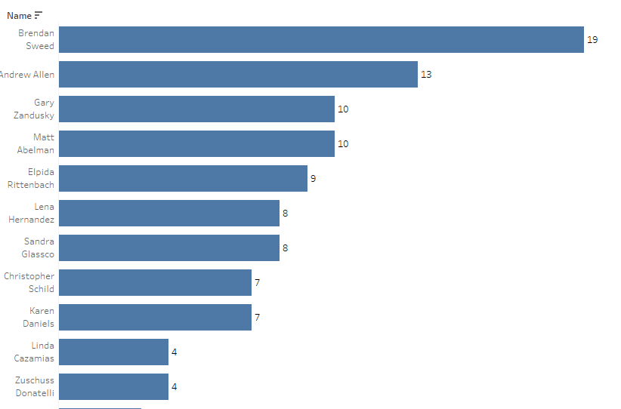
Most texts 2-5AM

Slide 6
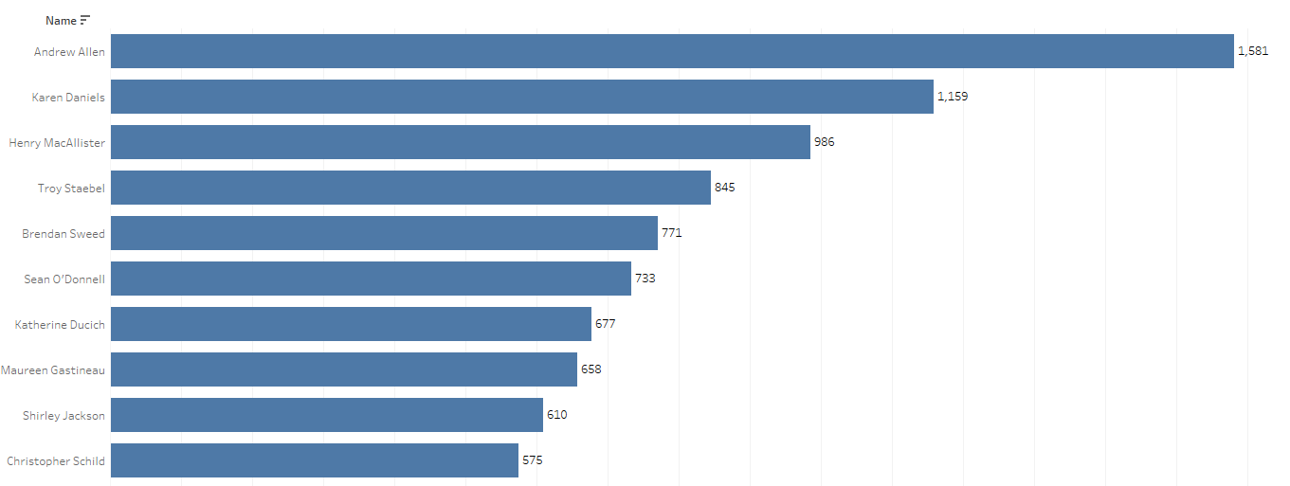
Longest Message

Slide 7
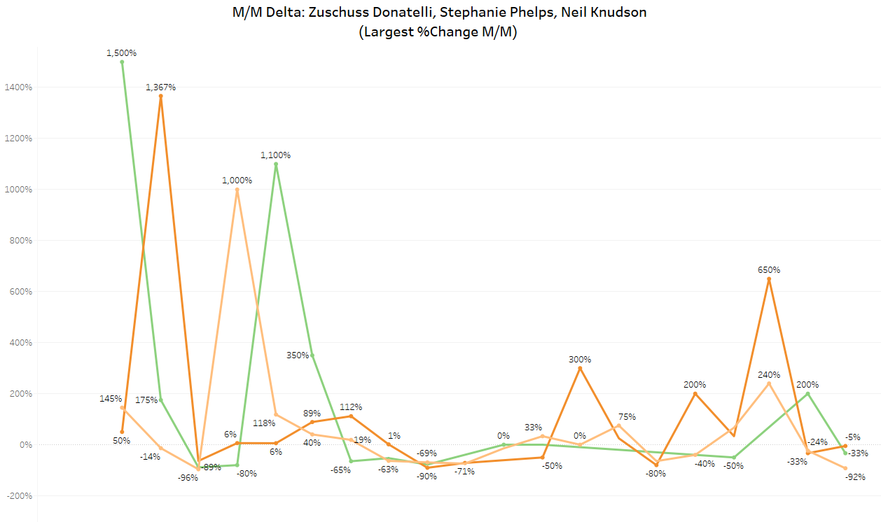
“they only talk to me when they need me”
Largest total M/M change in participation

Slide 8
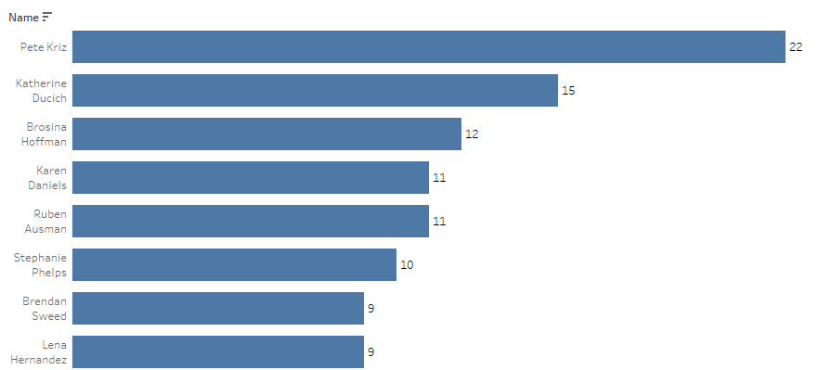
Most deleted Messages

Slide 9
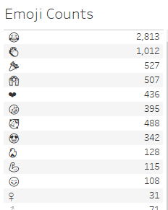
Most Popular Emojis

Slide 10
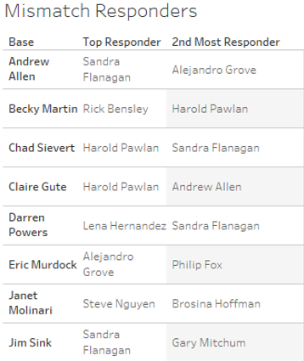
The “crush metric”: disproportionate Response rate to a specific person

